Slide 1
Database Operation
http://goo.gl/QvSEz0
CS5200 DBMS
Bruce Chhay

Slide 2
Database Operation
L1. Transactions

Slide 3
Integrity of a Database
Physical factors: power failures, errors, crashes, concurrency, etc.
Transaction: unit of work that may consist of multiple read/write operations.
Syntax: START TRANSACTION … statements ... COMMIT | ROLLBACK
Alternatively without START TRANSACTION, each statement that modifies a table is automatically committed.
Transactions have ACID properties.
Notes:
Data Integrity:
Entity integrity: Data types, column options, and primary key constraints
Referential integrity: Foreign key constraints
Business rule integrity: Triggers, application-specific

Slide 4
Atomicity
Atomicity - all operations in a transaction must occur, or nothing occurs.
Journaling through a chronological record of operations.
Temporary copies of data being modified by active transactions.
Commit: transaction is complete, write temporary data to disk (usually), so another transaction can be started.
Rollback: undo operations in the transaction, using the journal and discarding temporary copies (undo log).

Slide 5
Consistency
Consistency - a transaction brings the database from one valid state to another.
Future transactions can view the effects of past transactions, but earlier transactions cannot view the effects of future transactions.
Integrity constraints are not violated (pk, fk, cascade, etc.).

Slide 6
Isolation
Isolation - ability to reproduce the same results when multiple transactions are occurring at the same time.

Slide 7
Isolation
Different levels of isolation trade off concurrency performance:
Serializable: use read/write locks on entire table(s) so that concurrent execution of transactions yield results as if they were executed one after another (standard SQL default).

Slide 8
Isolation
Different levels of isolation trade off concurrency performance:
Serializable
Repeatable read: lock on rows being read. Phantom read can occur: running the same query twice in the same transaction results in more records because a new record was inserted that matches the WHERE clause of the query. Consistent read using multiversion concurrency control (MVCC): instead of using locks, use snapshots based on when the first read operation is performed.
Transaction 1 | Transaction 2
Phantom Read
SELECT * FROM BlogPosts WHERE Title LIKE ‘%cat%’;
 | INSERT INTO BlogPosts(Title) VALUES (‘Moar cats’);
SELECT * FROM BlogPosts WHERE Title LIKE ‘%cat%’;
Notes:
Dead locking: two+ concurrent transactions are unable to proceed because each holds a lock that the other needs. Usually when concurrent transactions each lock multiple tables but in opposite order. Automatically detected by a timeout, and victim (transaction with fewest updated rows) is rolled back.
Repeatable read is the default MySQL (InnoDB). MySQL uses MVCC (and row/range locking for modifying operations like UPDATE/DELETE).

Slide 9
Isolation
Different levels of isolation trade off concurrency performance:
Serializable
Repeatable read
Read committed: can read any committed data (no read lock), so the read in a transaction depends on the timing of concurrent transactions. Non-repeatable read can occur: the same record is retrieved twice but the second time returns different values. Technically a violation of transactional isolation.
Transaction 1 | Transaction 2
Non-repeatable Read
SELECT * FROM BlogPosts WHERE PostId=1;
 | UPDATE BlogPosts SET Title=’Cat nap’ WHERE PostId=1;
SELECT * FROM BlogPosts WHERE PostId=1;

Slide 10
Isolation
Different levels of isolation trade off concurrency performance:
Serializable
Repeatable read
Read committed
Read uncommitted: no waiting for other transactions. Dirty read can occur: retrieval of data that is not yet committed. No isolation guarantees.
Transaction 1 | Transaction 2
Dirty Read
SELECT * FROM BlogPosts WHERE PostId=1;
 | UPDATE BlogPosts SET Title=’Cat nap’ WHERE PostId=1;
SELECT * FROM BlogPosts WHERE PostId=1;
 | ROLLBACK

Slide 11
Durability
Durability - once a transaction is committed, then it will remain permanently even after crashes.
Write the transaction journal entry to persistent disk before commit is signaled.
To recover from a crash, the committed transactions that were written to the journal but the results not yet saved to disk are re-applied (redo log).

Slide 12
Database Operation
L2. Storage

Slide 13
Storage
MySQL default storage engine: InnoDB (Previously: MyISAM).
Data in a table is divided into pages.
Each page is fixed at 16KB (most disks have 4KB sectors), and can contain one or more rows. Balance of size: large enough to hold the data for most rows, and small enough for transferring between memory-disk (especially when individual row is updated).
Compact format for nulls and variable-length fields, compressed saves more disk (at the expense of CPU).
Overflow pages: varchar, blob columns that are too long to fit on a page are stored in singly linked lists.
Notes:
http://dev.mysql.com/doc/refman/5.7/en/innodb-storage-engine.html http://dev.mysql.com/doc/refman/5.7/en/myisam-storage-engine.html http://dev.mysql.com/doc/refman/5.7/en/storage-engines.html

Slide 14
Storage
Tablespace: data file (.ibd file) containing one or more tables and its indexes.
(Table metadata, such as table definition, is kept in .frm file.)
The system tablespace (ibdata1, ibdata2 files) contain metadata about the tables (data dictionary) and store journals (such as undo log; redo logs are stored in the log group: ib_logfile0, ib_logfile1 files).
Default is one file per table for easier space management and backups.
A table can be partitioned into multiple files to handle large tables.
Notes:
http://dev.mysql.com/doc/refman/5.7/en/partitioning.html

Slide 15
Indexes
Index: tree data structure for fast row lookup.
Clustered index: storage organization of the entire table (all rows and all columns) based on the primary key columns to speed up queries involving the primary keys. A table only has one clustered index.
Secondary index: index for a subset of table columns. A table can have any number of secondary indexes. Useful for queries that can be computed entirely from indexes without need to read actual table data (covering index). Otherwise, can be used to identify the relevant rows in a query, which are then retrieved using the clustered index. Creation involves overhead for copying data from the table. FK constraints create an index so parent-child checks can be done quickly (including FK constraint cascading).
Notes:
Tree data structure: B+ tree is the default for InnoDB. In-memory storage engines and NDB also support hash indexes.
Secondary index is an index to primary index. So two scans are required.
Strategy in Oracle DB: Alternatively, a “physical guess” (based on the storage location when the row was first created) can be used to reduce the second scan. If the guess is wrong, then the second scan is run.

Slide 16
Indexes
Indexes are essential to performance and database administration. Choose pks wisely, based on expected queries. Expensive to modify which columns belong to the primary key due to the need to rebuild the clustered index.
If only PK-FK joins are performed, then default clustered and secondary indexes usually suffice. Add more secondary indexes if:
Frequent JOINs do not use PK-FK relationships.
Frequent lookups for specific columns or column lists.

Slide 17
Index Syntax
CREATE INDEX index_name
ON tbl_name (index_col_name,...)
Notes:
http://dev.mysql.com/doc/refman/5.7/en/create-index.html index_name must be unique in your schema.

Slide 18
B-tree
Search, insert, delete operations are O(log n) average and worst case.
Storage is O(n).
Sorted at all times to enable fast lookups for exact matches (equality operator) and ranges (greater than, less than operators).

Slide 19
B+ tree
Structure (see next slide):
n-ary, variable number of children instead of two in a binary tree.
Keys are separators to divide subtrees. Keys chosen by index definition.
Values of internal nodes point to subtrees. Balance achieved by requiring all leaf nodes to have same depth.
B+ tree: similar as B-tree
Leaves are linked (via linked-list) to allow fast range queries.
Leaves contains a key and value. Value contains row data (pages).
(Alternative is a hash index, which only supports exact matches.)
Notes:
Common when accessing data (disk IO) is slower than processing (CPU).
Frequently a large number of internal nodes to reduce height of tree and thus node accesses (IO operations) for lookup, which can be very slow on disk.
Useful for block storage. Sorted order useful for sequential traversing.
Self-balancing (via splitting/combining) to maintain same height for all leaf nodes.
Branching factor, b: capacity of child nodes (number of nodes a node can contain).
Actual number of contained children nodes, m, is b/2 <= m <= b for splitting/combining.
Disadvantages: redefining branching factor requires a full rebuild.

Slide 20
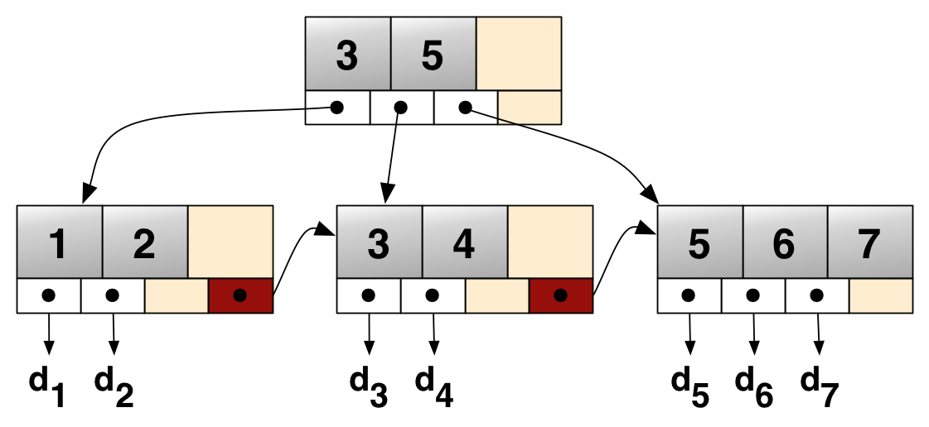
B+ tree
http://upload.wikimedia.org/wikipedia/commons/3/37/Bplustree.png

Slide 21
Caching
Buffer pool: in-memory, linked list of pages using least-recently-used caching for table (including results) and index data.
Can have multiple pools for better concurrency.
Pages (16KB) are transferred between disk and memory. (Disk sectors usually 4KB.)
Disk is 80x slower than memory (SSD is 4x slower than memory).
Notes:
Latency of operations on a computer: http://norvig.com/21-days.html#answers

Slide 22
Caching
Integration with memcached daemon (in-memory LRU caching layer) to store and retrieve directly from InnoDB.
(memcached API: get, set/add/replace, incr/decr.)
Clients can store/retrieve results from memcached directly and MySQL can store/retrieve from memcached.
Notes:
http://dev.mysql.com/doc/refman/5.7/en/innodb-memcached.html
LRU: last-recently used. Pattern: recently used will be used soon after again.

Slide 23
Optimizations
Normalization (and small lookup tables for frequently scanned values).
Understanding logical query execution.
Use EXPLAIN to view a query execution plan. DESCRIBE BlogApplication.BlogPosts; EXPLAIN SELECT * FROM BlogApplication.BlogPosts WHERE PostID = 1;
DTrace for probing queries and resource utilization.
Benchmarking.
Storage, indexing, caching.
Availability and scalability.
And more...
Notes:
http://dev.mysql.com/doc/refman/5.7/en/execution-plan-information.html http://dev.mysql.com/doc/refman/5.7/en/dba-dtrace-server.html http://dev.mysql.com/doc/refman/5.7/en/optimization.html http://dev.mysql.com/doc/refman/5.7/en/extending-mysql.html

Slide 24
Database Operation
L3. Clustering & Replication

Slide 25
Clustering & Replication
Availability and scalability through cluster nodes and data replication.
Nodes: management nodes for coordination, Network Database (NDB in-memory storage engine) data nodes for storing tables (shards and replicas), and MySQL daemon (mysqld) for accessing data.
Notes:
High availability through read-only replicas in InnoDB cluster. One primary for read-write. If primary fails, then one secondary promoted to primary:
http://dev.mysql.com/doc/refman/5.7/en/mysql-innodb-cluster-userguide.html
To scale-out for high availability, high redundancy, and distributed computing, NDB is used. MySQL v7 is NDB (v5 and v8 is InnoDB; v6 scrapped due to poor performance). http://dev.mysql.com/doc/refman/5.7/en/mysql-cluster.html http://dev.mysql.com/doc/refman/5.7/en/replication.html
“mysqld, also known as MySQL Server, is the main program that does most of the work in a MySQL installation. MySQL Server manages access to the MySQL data directory that contains databases and tables. The data directory is also the default location for other information such as log files and status files.” http://dev.mysql.com/doc/refman/5.7/en/mysqld.html

Slide 26
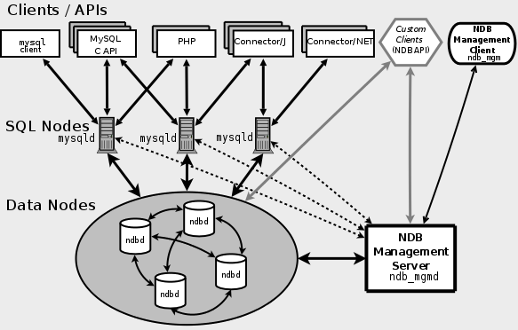
Clustering & Replication
http://dev.mysql.com/doc/refman/5.7/en/mysql-cluster-overview.html

Slide 27
Clustering & Replication
Consistency/Isolation can use two-phase locking (with a distributed lock manager):
Expanding phase: locks are acquired (none released).
Shrinking phase: locks are released (none acquired).
Atomicity/Durability can use two-phase commit:
Commit-request: coordinator signals a vote from participants whether to commit a transaction or not.
Commit phase: coordinator decides to commit or abort based on the votes. Participants then commit or abort their local resources.
Notes:
Atomicity: all or nothing.
Consistency: valid state, database integrity.
Isolation: reproduce same results with concurrent transactions.
Durability: committed data is permanent.
InnoDB replication: asynchronous. No locking model required since only primary allows writes.
NDB: synchronous. Require two-phase lock and commit since all nodes can read and write.

Slide 28
Storage Comparison
Feature | MyISAM | InnoDB | NDB
Transactions | No | Yes | Yes
Locking granularity | Table | Row | Row
MVCC | No | Yes | Yes
Storage limit | 256TB | 64TB | 384EB
Compressed data | Yes | Yes | No
Data caches | No | Yes | Yes
Clustered indexes | No | Yes | No
B-tree indexes | Yes | Yes | Yes
Backup/recovery | Yes | Yes | Yes
Replication | Yes | Yes | Yes
Clustering | No | No | Yes

Slide 29
Projects
Presentation signups.
Milestone 5
CloverETL: what ETLs are teams using?
Examples of external data sources?
Interesting analysis and reporting?
Notes:
Presentation signups: http://goo.gl/ENQiuN

